Slide 1

IndustrialDoc: Smart Machine Documentation System
Motion Minds presents IndustrialDoc, a secure and efficient file management solution. Designed specifically for the complexities of industrial documentation. Our system streamlines access, enhances security, and boosts productivity. Say goodbye to documentation chaos and embrace seamless management.

Slide 2




The High Cost of Unmanaged Documentation
Documentation Overload
Security risks
Current methods are inefficient, insecure, and difficult to manage, which can lead to breaches.
Industrial machinery's rising complexity causes documentation to grow exponentially.
Time wasted
Engineers lose 20% of their time searching for documents.

Slide 3
IndustrialDoc: A Smarter Solution
Centralized Repository
Key Features
A secure place for industrial documentation.
Advance Filtering
Access control
Advanced search

Slide 4
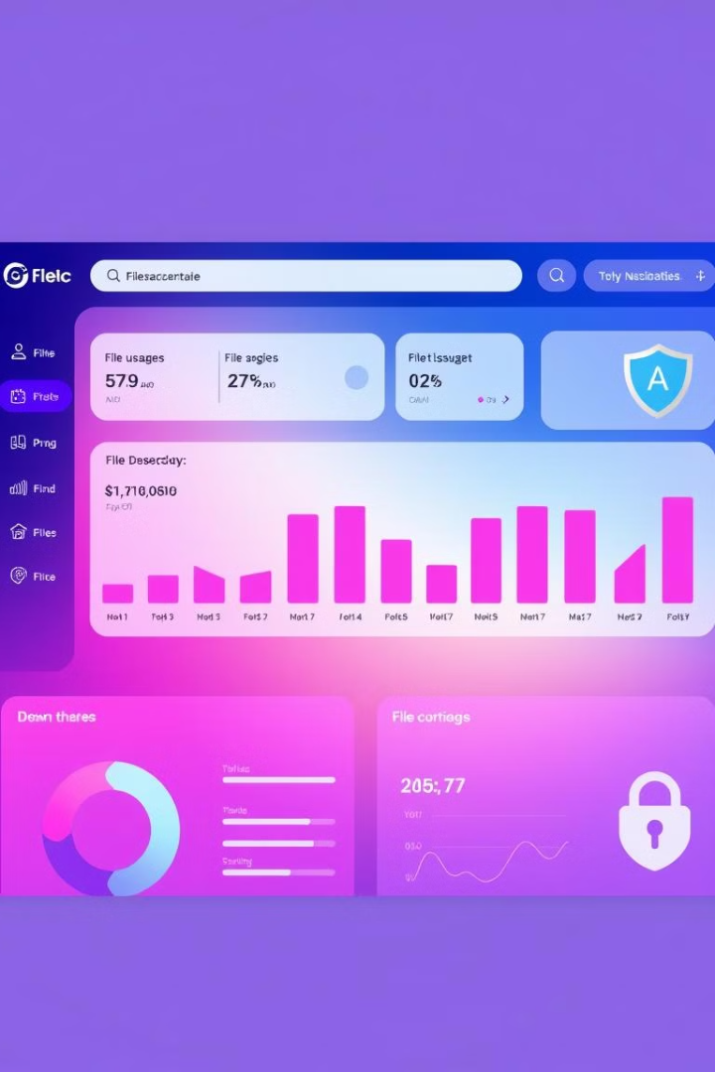




Key Features of IndustrialDoc
File Management
Security
Search
Mobile-Friendly

Slide 5





Under the Hood: Technical Requirements
Security
1
cryptography.fernet
Images
2
PIL
QR code
3
qrcode 7.4.2
Web framework
4
Werkzeug 3.0.1, Flask 3.0.0
Language
5
Python 3.x

Slide 6



IndustrialDoc Usage Guide
Navigation
Home page overview
Admin
Secure the defaults
Security
Regular data backups

Slide 7

Thank You!
Thank you for considering IndustrialDoc. With IndustrialDoc, documentation becomes an asset, not a burden. It improves efficiency, security, and accessibility.

